Slide 1




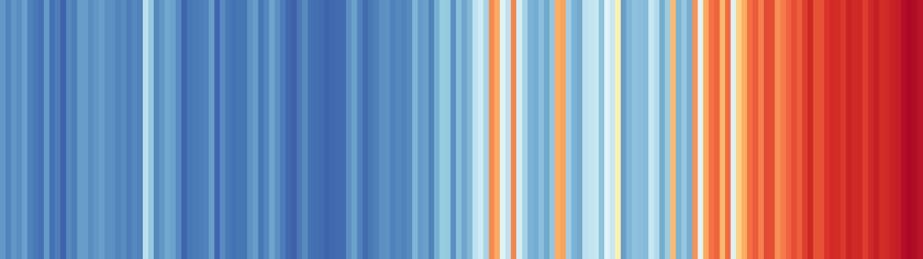





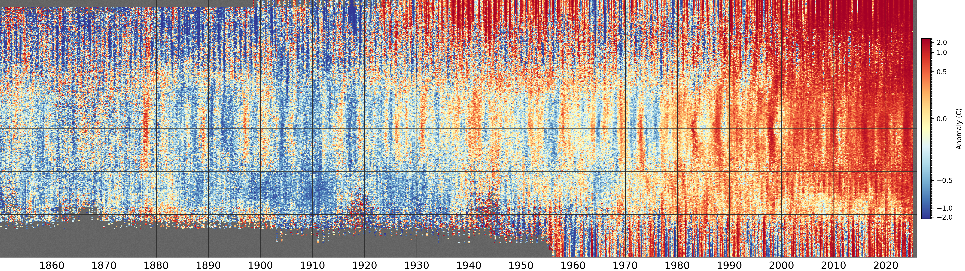



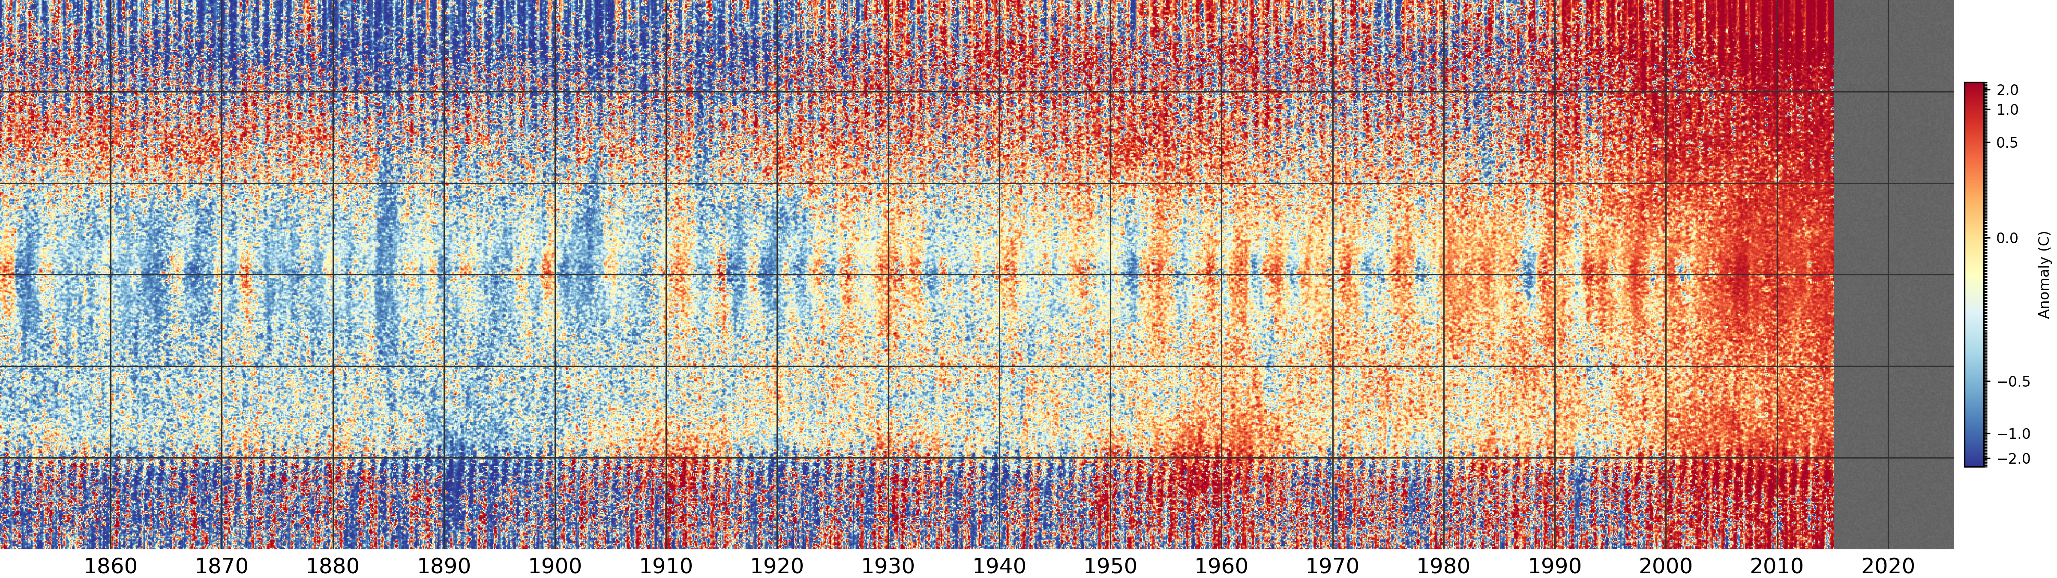

Show more stripes
Stripes,
Speckles,
Splotches, …
A classic!,
It’s a bit
boring.
What would a
professional stripes
plot look like?
What we
really need
is a detailed
explanation.
Get your feet out of the Early Twentieth
Century Warming.
Resolve
latitude –
North
at the
top.
Stripe by month, not year.
South
at the
bottom.
Sample in longitude.
Don’t average.
It’s much cleaner if we use model output instead of observations.
Do we have to model the apocalypse as early as 2015?
No problems with
missing data.
Inspiration
showyourstripes.info
xkcd
Richard Scarry
Data sources
HadCRUT5
GC5-Central
Cartoon figures
Google Gemini 2.5
Everything else
Philip Brohan
2025-09-29

